Slide 2
Topics
Introduction
Hardware and Software
How Computers Store Data
How a Program Works
Using Python

Slide 3
Introduction
Computers can be programmed
  Designed to do any job that a program tells them to
Program: set of instructions that a computer follows to perform a task
  Commonly referred to as Software
Programmer: person who can design, create, and test computer programs
  Also known as software developer

Slide 4
Hardware and Software
Hardware: The physical devices that make up a computer
  Computer is a system composed of several components that all work together
Typical major components:
  Central processing unit
  Main memory
  Secondary storage devices
  Input and output devices

Slide 5
The CPU
Central processing unit (CPU): the part of the computer that actually runs programs
  Most important component
  Without it, cannot run software
  Used to be a huge device
Microprocessors: CPUs located on small chips

Slide 6
Main Memory
Main memory: where computer stores a program while program is running, and data used by the program
Known as Random Access Memory or RAM
  CPU is able to quickly access data in RAM
  Volatile memory used for temporary storage while program is running
  Contents are erased when computer is off

Slide 7
Secondary Storage Devices
Secondary storage: can hold data for long periods of time
  Programs normally stored here and loaded to main memory when needed
Types of secondary memory
  Disk drive: magnetically encodes data onto a spinning circular disk
  Solid state drive: faster than disk drive, no moving parts, stores data in solid state memory
  Flash memory: portable, no physical disk
  Optical devices: data encoded optically

Slide 8
Input Devices
Input: data the computer collects from people and other devices
Input device: component that collects the data
  Examples: keyboard, mouse, touchscreen, scanner, camera
  Disk drives can be considered input devices because they load programs into the main memory

Slide 9
Output Devices
Output: data produced by the computer for other people or devices
  Can be text, image, audio, or bit stream
Output device: formats and presents output
  Examples: video display, printer
  Disk drives and USB drives can be considered output devices because data is sent to them to be saved

Slide 10
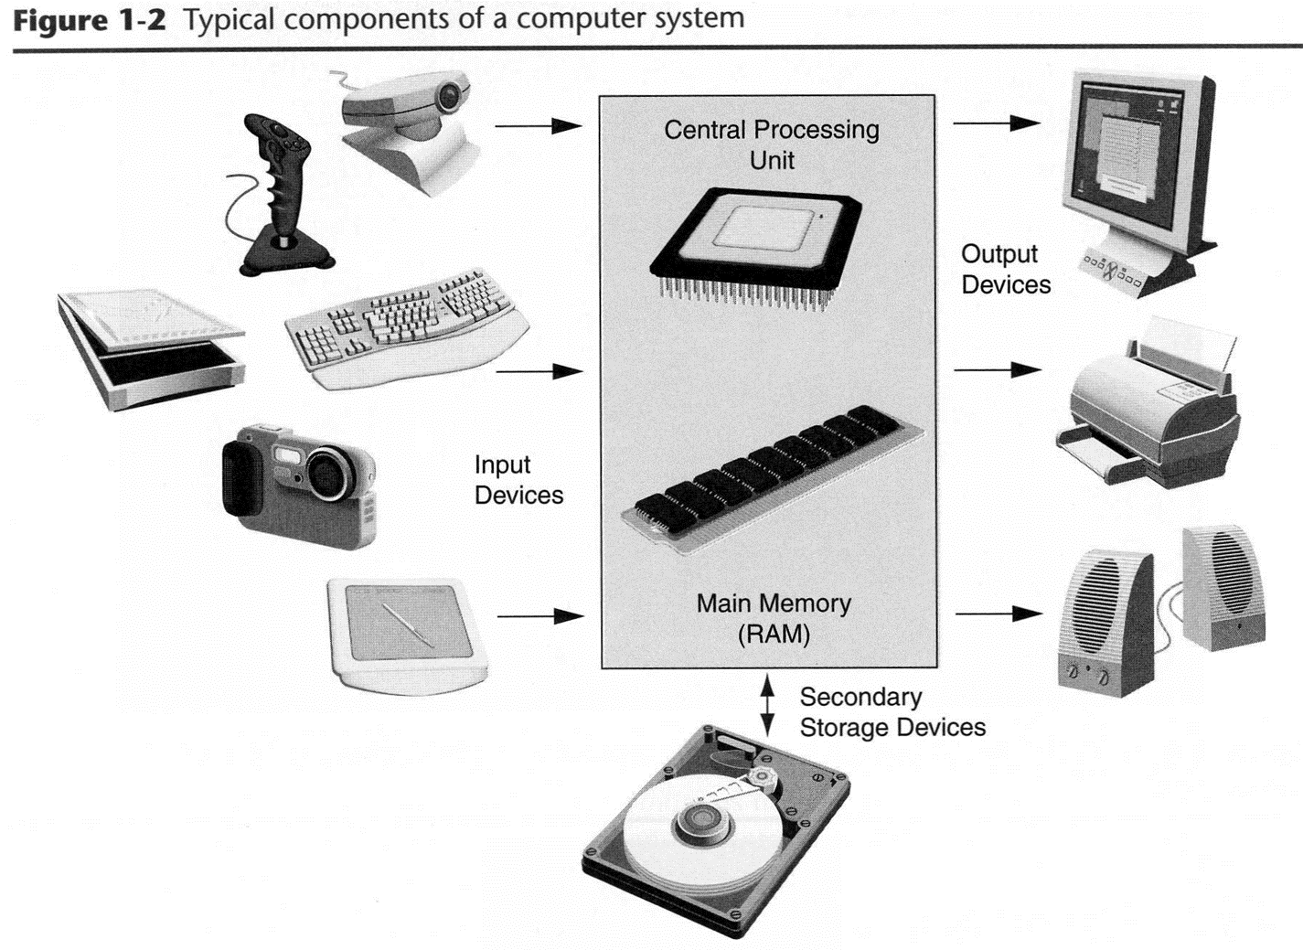

Slide 11
Software
Everything the computer does is controlled by software
  General categories:
    Application software
    System software
Application software: programs that make computer useful for every day tasks
  Examples: word processing, email, games, and Web browsers

Slide 12
Software (cont’d.)
System software: programs that control and manage basic operations of a computer
  Operating system: controls operations of hardware components
  Utility Program: performs specific task to enhance computer operation or safeguard data
  Software development tools: used to create, modify, and test software programs

Slide 13
How Computers Store Data
All data in a computer is stored in sequences of 0s and 1s
Byte: just enough memory to store letter or small number
  Divided into eight bits
  Bit: electrical component that can hold positive or negative charge, like on/off switch
  The on/off pattern of bits in a byte represents data stored in the byte

Slide 14
Storing Numbers
Bit represents two values, 0 and 1
Computers use binary numbering system
  Position of digit j is assigned the value 2^{j-1}
  To determine value of binary number sum position values of the 1s
Byte size limits are 0 and 255
  0 = all bits off; 255 = all bits on
  To store larger number, use several bytes

Slide 15
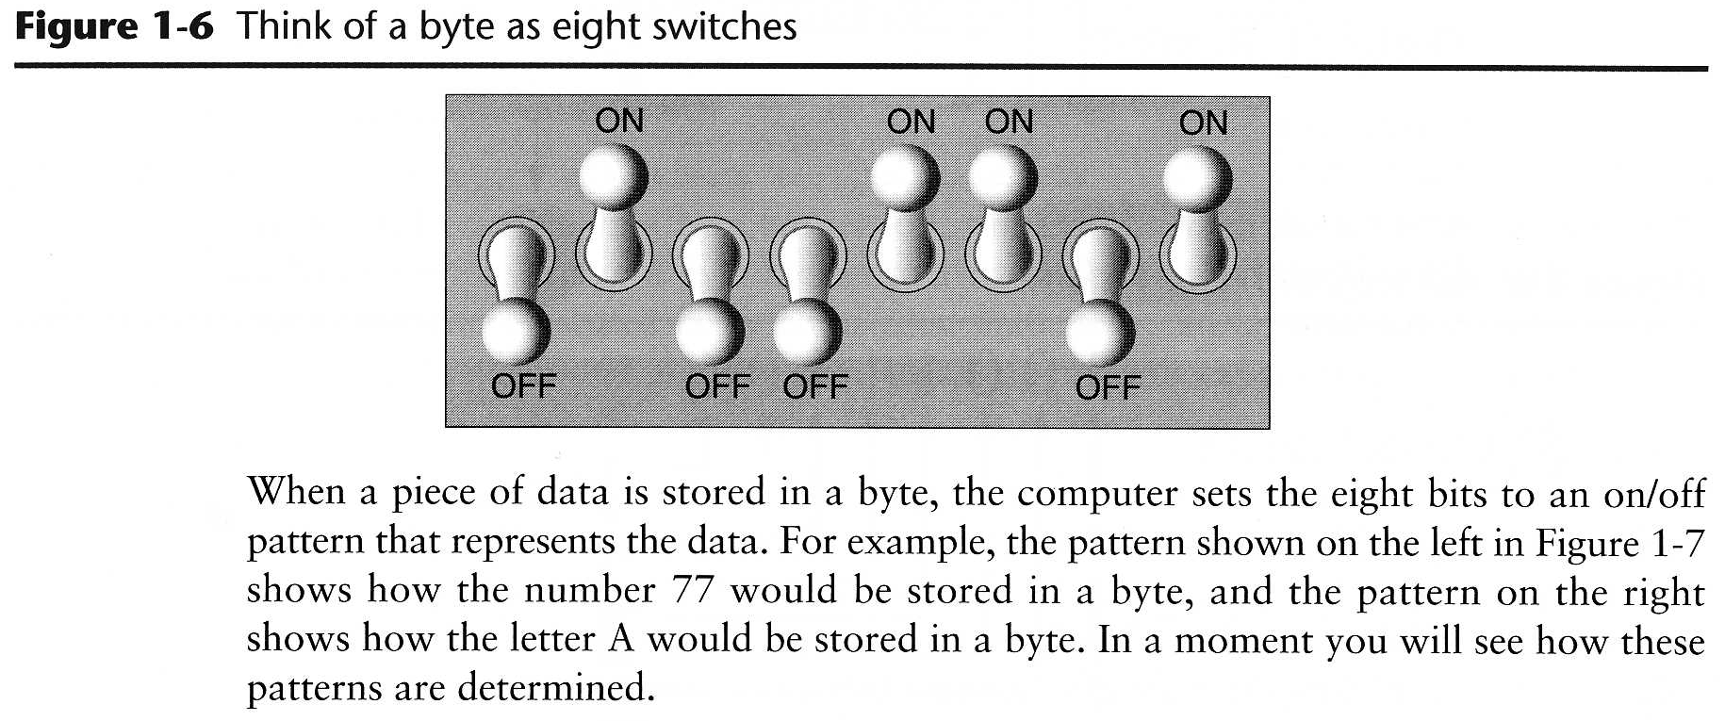

Slide 16
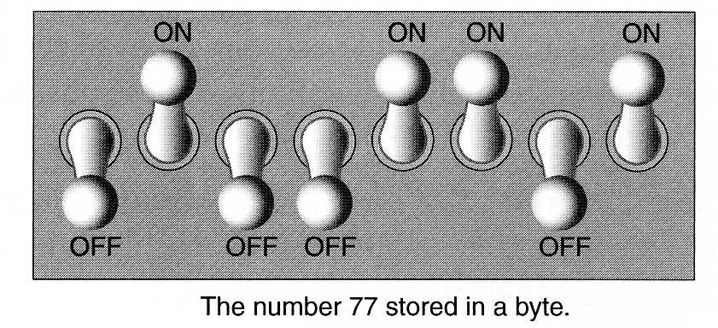
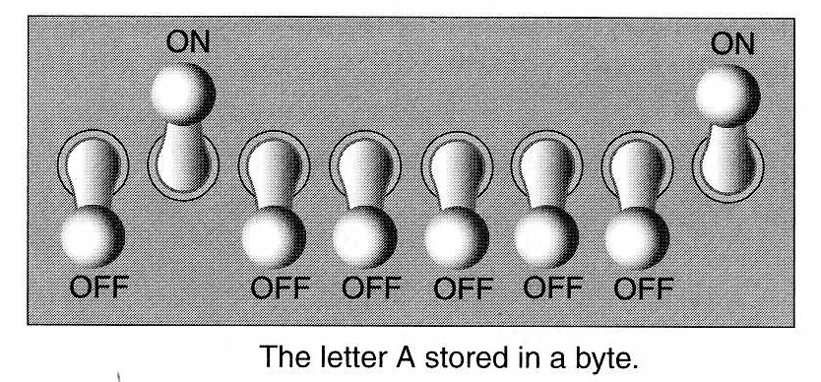

Slide 17
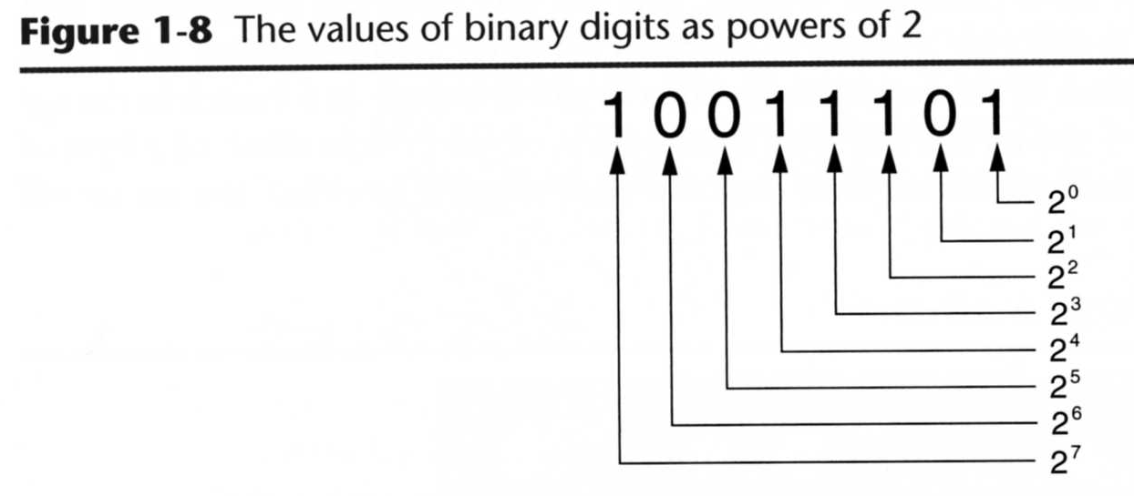

Slide 18
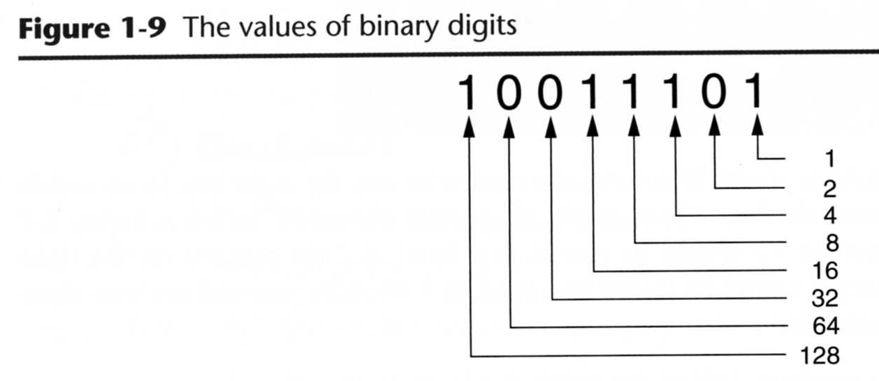

Slide 19
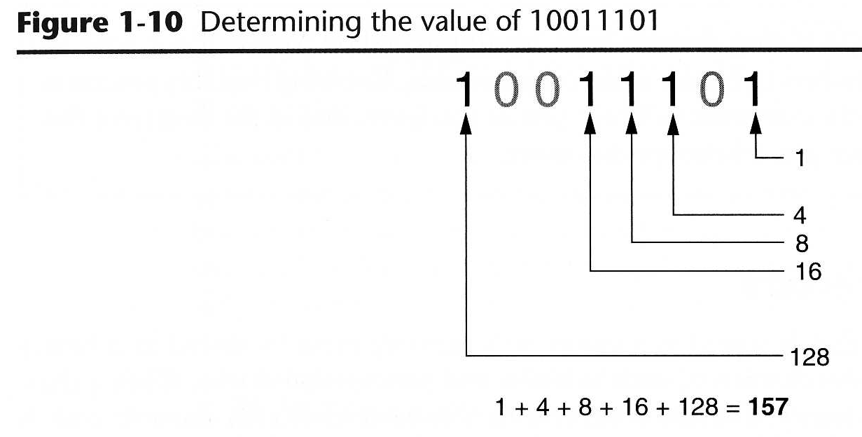

Slide 20
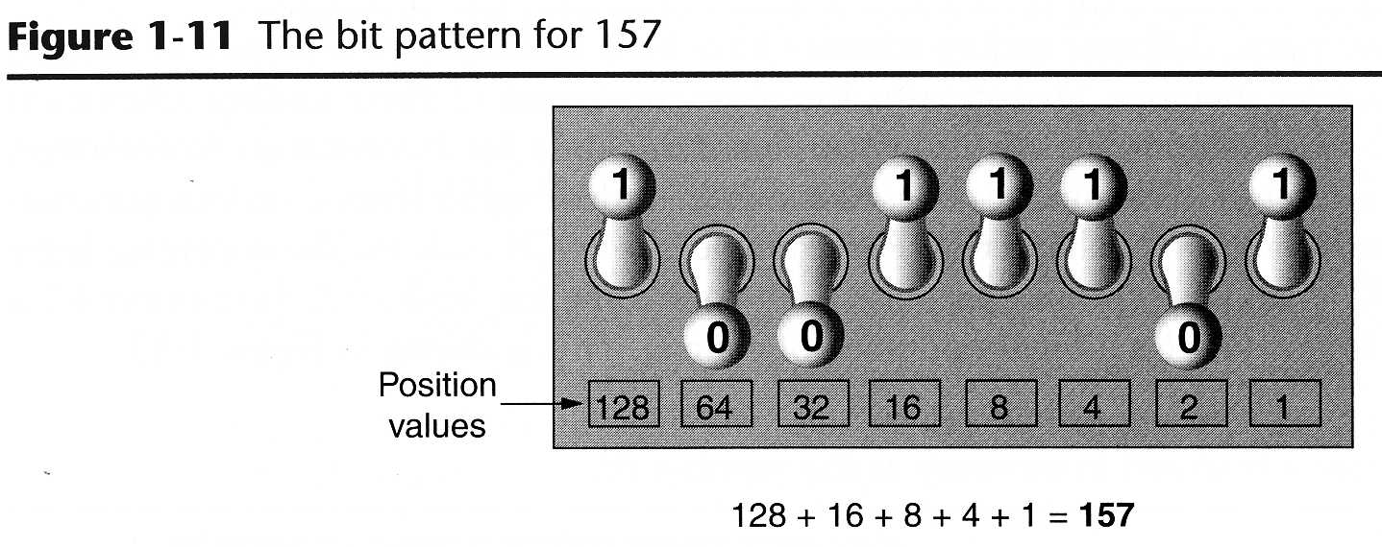

Slide 21
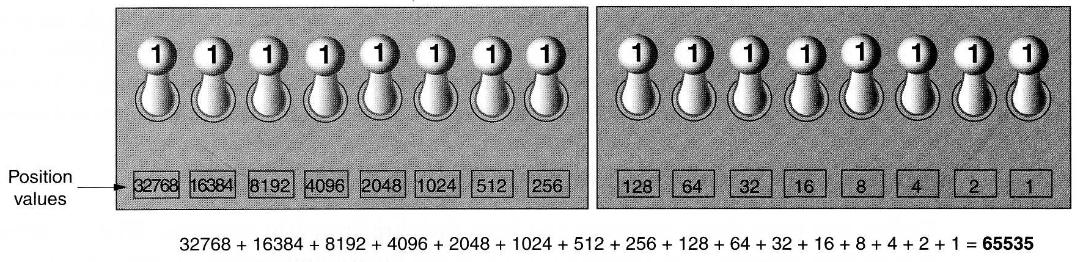

Slide 22
Storing Characters
Data stored in computer must be stored as binary number
Characters are converted to numeric code, numeric code stored in memory
  Most important coding scheme is ASCII
    ASCII is limited: defines codes for only 128 characters
  Unicode coding scheme becoming standard
    Compatible with ASCII
    Can represent characters for other languages

Slide 23
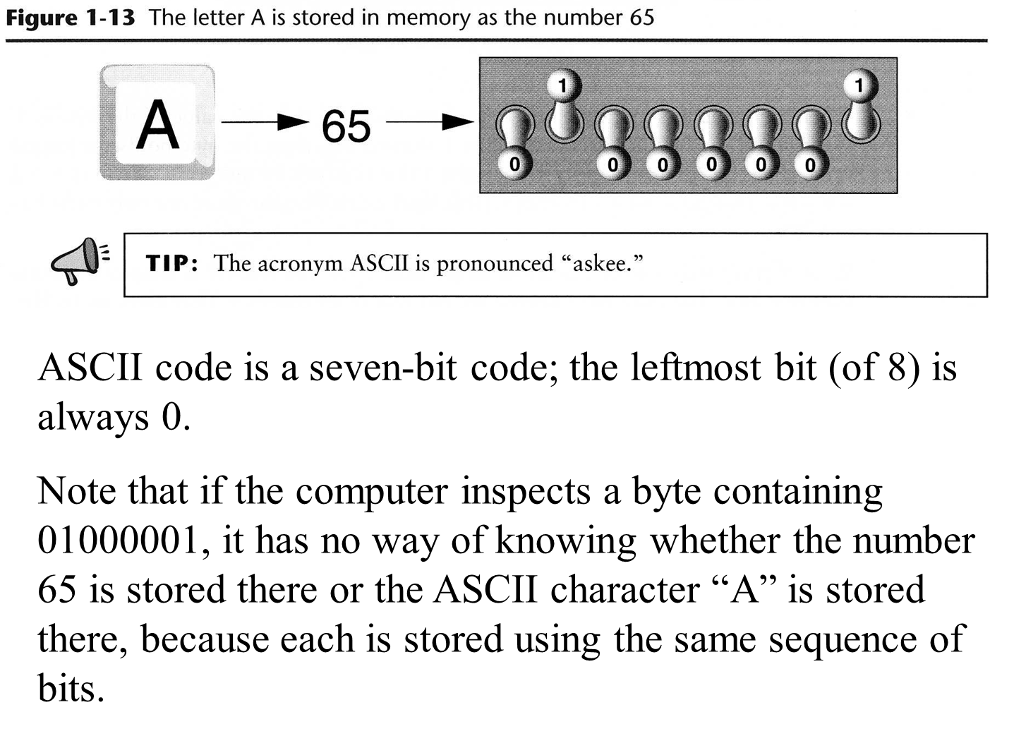

Slide 24
Advanced Number Storage
To store negative numbers and real numbers, computers use binary numbering and encoding schemes
  Negative numbers encoded using two’s complement
  Real numbers encoded using floating-point notation

Slide 25
Other Types of Data
Digital: describes any device that stores data as binary numbers
Digital images are composed of pixels
  To store images, each pixel is converted to a binary number representing the pixel’s color
Digital music is composed of sections called samples
  To store music, each sample is converted to a binary number

Slide 26
How a Program Works
CPU designed to perform simple operations on pieces of data
  Examples: reading data, adding, subtracting, multiplying, and dividing numbers
  Understands instructions written in machine language and included in its instruction set
    Each brand of CPU has its own instruction set
To carry out meaningful calculation, CPU must perform many operations

Slide 27
How a Program Works (cont’d.)
Program must be copied from secondary memory to RAM each time CPU executes it
CPU executes program in cycle:
  Fetch: read the next instruction from memory into CPU
  Decode: CPU decodes fetched instruction to determine which operation to perform
  Execute: perform the operation

Slide 28
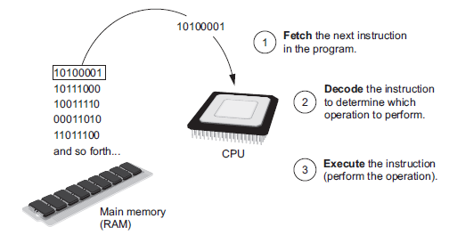
How a Program Works (cont’d.)
Figure 1-16 The fetch-decode-execute cycle

Slide 29
From Machine Language to Assembly Language
Impractical for people to write in machine language
Assembly language: uses short words (mnemonics) for instructions instead of binary numbers
  Easier for programmers to work with
Assembler: translates assembly language to machine language for execution by CPU

Slide 30
High-Level Languages
Low-level language: close in nature to machine language
  Example: assembly language
High-Level language: allows simple creation of powerful and complex programs
  No need to know how CPU works or write large number of instructions
  More intuitive to understand

Slide 31
Key Words, Operators, and Syntax: an Overview
Key words: predefined words used to write program in high-level language
  Each key word has specific meaning
Operators: perform operations on data
  Example: math operators to perform arithmetic
Syntax: set of rules to be followed when writing program
Statement: individual instruction used in high-level language

Slide 32
Compilers and Interpreters
Programs written in high-level languages must be translated into machine language to be executed
Compiler: translates high-level language program into separate machine language program
  Machine language program can be executed at any time

Slide 33
Compilers and Interpreters (cont’d.)
Interpreter: translates and executes instructions in high-level language program
  Used by Python language
  Interprets one instruction at a time
  No separate machine language program
Source code: statements written by programmer
  Syntax error: prevents code from being translated

Slide 34
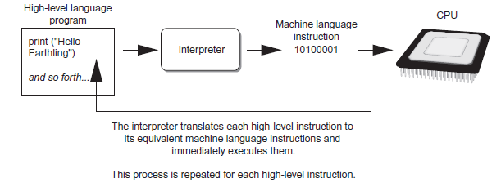
Compilers and Interpreters (cont’d.)
Figure 1-19 Executing a high-level program with an interpreter

Slide 35
Using Python
Python must be installed and configured prior to use
  One of the items installed is the Python interpreter
Python interpreter can be used in two modes:
  Interactive mode: enter statements on keyboard
  Script mode: save statements in Python script

Slide 36
Interactive Mode
When you start Python in interactive mode, you will see a prompt
  Indicates the interpreter is waiting for a Python statement to be typed
  Prompt reappears after previous statement is executed
  Error message displayed If you incorrectly type a statement
Good way to learn new parts of Python

Slide 37
Writing Python Programs and Running Them in Script Mode
Statements entered in interactive mode are not saved as a program
To have a program use script mode
  Save a set of Python statements in a file
  The filename should have the .py extension
  To run the file, or script, type
  python filename
  at the operating system command line

Slide 38
The IDLE Programming Environment
IDLE (Integrated Development Program): single program that provides tools to write, execute and test a program
  Automatically installed when Python language is installed
  Runs in interactive mode
  Has built-in text editor with features designed to help write Python programs

Slide 39
Summary
This chapter covered:
  Main hardware components of the computer
  Types of software
  How data is stored in a computer
  Basic CPU operations and machine language
  Fetch-decode-execute cycle
  Complex languages and their translation to machine code
  Installing Python and the Python interpreter modes

